Slide 1
Relativity DW
By: Endri Rama

Slide 2
Background
Relativity is a law data vendor which was created in 2001 in Chicago Illinois and it helps clients out through the ETL process. Recently the client of relativity Winston Strawn needed Relativity to perform its ETL process and this is due to Winston Strawn's internal team having issues with their data storage (EDDR) facility. Winston Strawn is a Law Company that has been around since 1853 with its headquarters located here in Chicago. Relativity (the vendor) is now tasked with processing the data which Winston Strawn has agreed to until their EDDR consultants and IT teams can fix the issue.

Slide 3
Statement of Problem
After overseeing the data which was provided by Winston Strawn, Relativity decided it was best to clean up the data and re-organize everything. This would be extremely helpful to Winston Strawn as their internal team is still working on fixing the EDDR Facility. Relativity will then be providing the data through a WebAPI.

Slide 4
Goal
Warehouse the data and perform the ETL process through the data in order for it to become as concise as possible in order to be used in a court of law.

Slide 5
Where Data is being pulled from?
Data is being gathered from raw data of physical devices (logs), it is also being pulled from their data repository as well as data delivered to the Relativity Data Warehouse. The data mainly consists of emails as well as attachments for this project which consist of excel sheets, reports, cvs files. The data will then be placed in the staging area and a master template for this project will be created of this data.

Slide 6
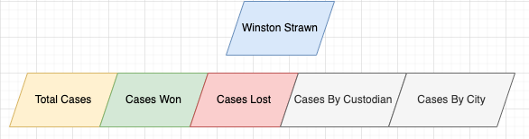
Business Process
Here we can see the business process of Winston Strawn

Slide 7
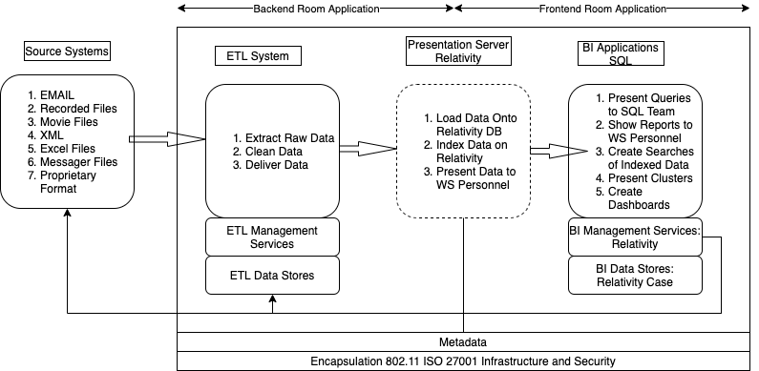
Architecture

Slide 8
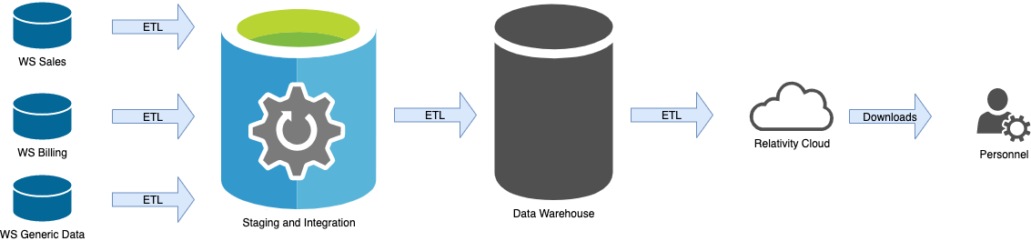
ETL\Data Flow Diagram

Slide 9
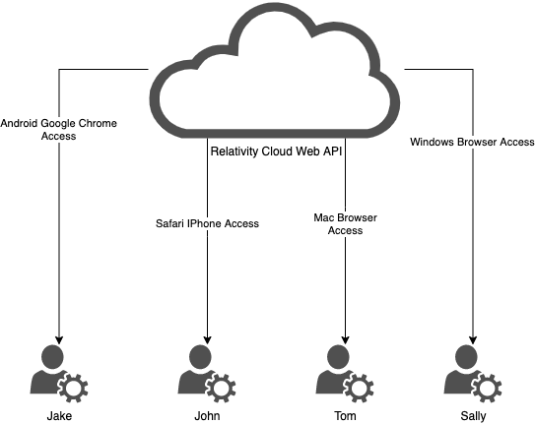
Data Flow: Users

Slide 10
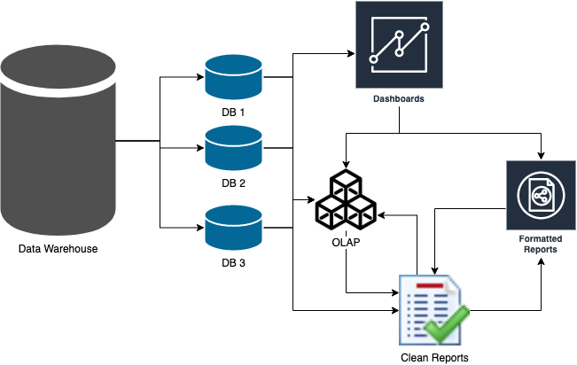
BI Layer

Slide 11
Data Sources
Source | Business Owner | IS Owner | Platform | Location | Description
EDDR | Winston Strawn | John Doe | IOS | HQ - Chicago | Email - Case #2259 - Alex Numan
EDDR | Winston Strawn | Sally Pulaski | Windows | HQ - Chicago | Email - Customer Billing
EDDR | Winston Strawn | Sally Pulaski | Windows | HQ - Chicago | Email - Customer Billing
EDDR | Winston Strawn | Jake Frontman | Android | HQ - Chicago | Email - Case #7352 - Harry Jacobson
EDDR | Winston Strawn | Tom Iverson | Unix/Mac | HQ - Chicago | Email - Sales Spreadsheet Q1
EDDR | Winston Strawn | Tom Iverson | Unix/Mac | HQ - Chicago | Email - Sales Spreadsheet Q2
EDDR | Winston Strawn | Tom Iverson | Unix/Mac | HQ - Chicago | Email - Sales Spreadsheet Q3

Slide 12
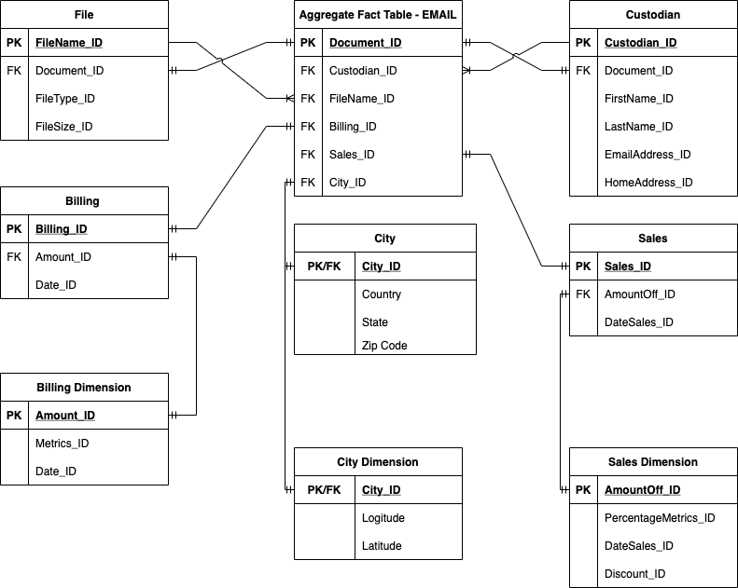
Entity Relationship Diagram

Slide 13
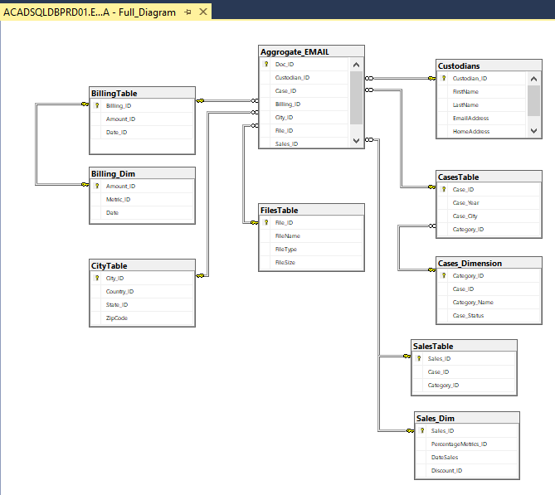
SQL Diagram

Slide 14
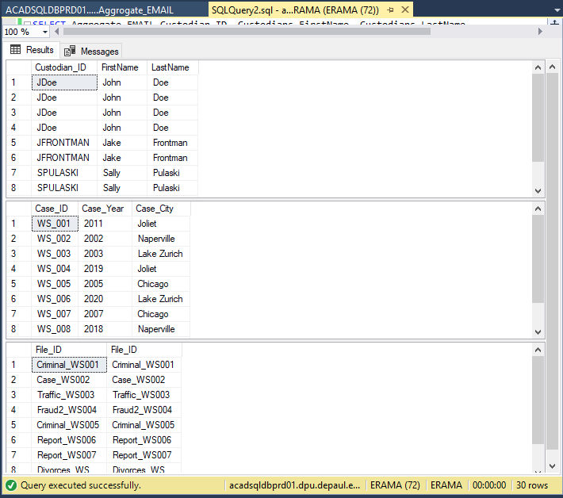
SQL Query: 1
SELECT Aggrogate_EMAIL.Custodian_ID, Custodians.FirstName, Custodians.LastName
FROM Custodians
FULL OUTER JOIN Aggrogate_EMAIL ON Custodians.Custodian_ID = Aggrogate_EMAIL.Custodian_ID
SELECT Aggrogate_Email.Case_ID, CasesTable.Case_Year, CasesTable.Case_City
From CasesTable
FULL OUTER JOIN Aggrogate_EMAIL ON CasesTable.Case_ID = Aggrogate_Email.Case_ID
SELECT Aggrogate_Email.File_ID, FilesTable.File_ID
From FilesTable
FULL OUTER JOIN Aggrogate_EMAIL ON FilesTable.File_ID = Aggrogate_Email.File_ID
Order by CASE_ID;

Slide 15
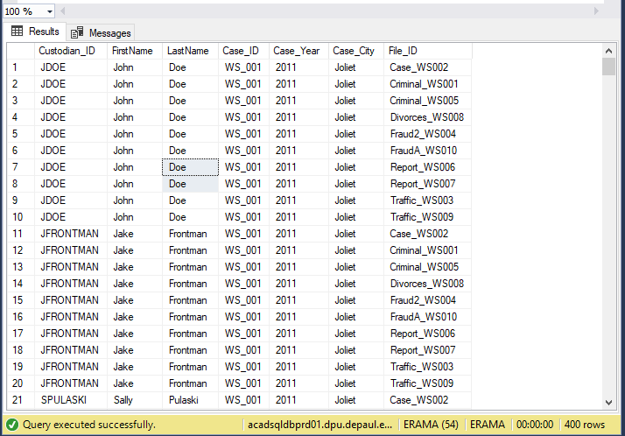
SQL Query: 2
SELECT Custodian_ID, FirstName, LastName,
Case_ID, Case_Year, Case_City, File_ID
From Custodians, CasesTable, FilesTable
Order by Case_ID, Custodian_ID

Slide 16
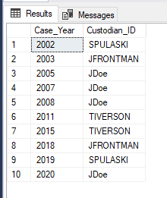
SQL Query: 3
SELECT Case_Year, Custodian_ID From Aggrogate_EMAIL
Inner Join CasesTable On Aggrogate_EMAIL.Case_ID = CasesTable.Case_ID
Order by Case_Year;

Slide 17
Dimensions
Star Schema Structure
Aggrregate_Email_Table
Custodians
Case
FilesTable
City
Sales
Sales_Dimension
Billing
Billing_Dimension

Slide 18
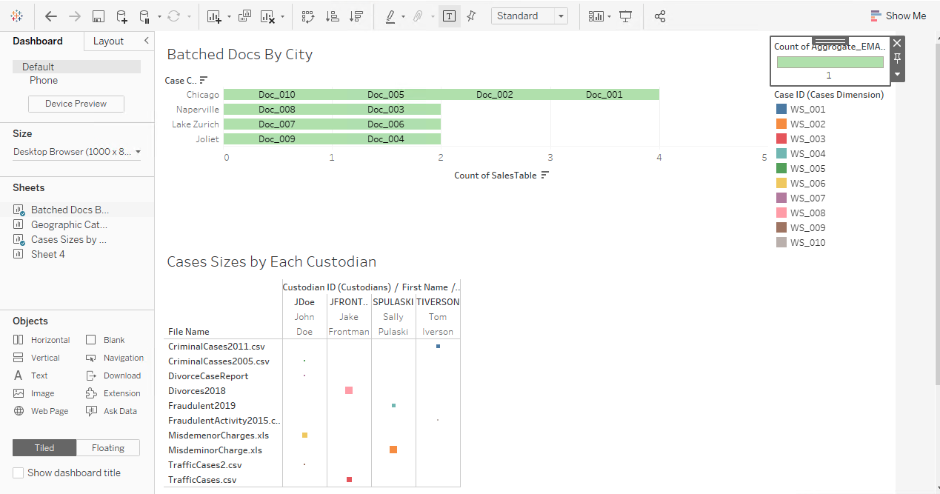
Dashboard 1 Tableau

Slide 19
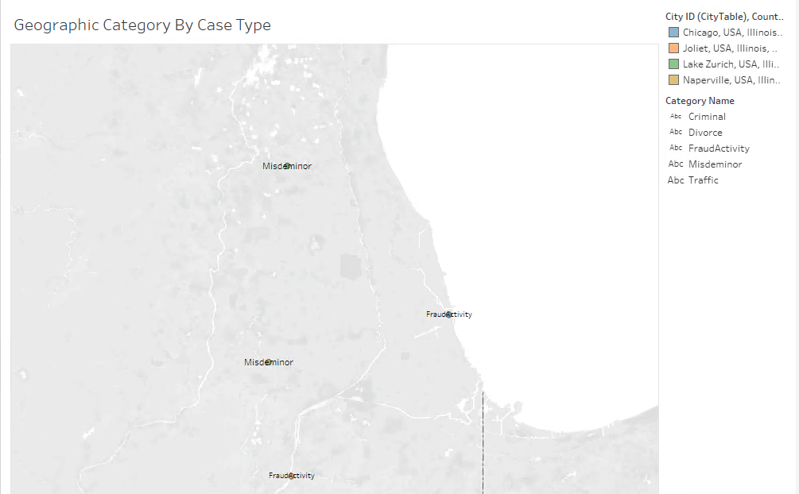
Dashboard 2 Tableau

Slide 20
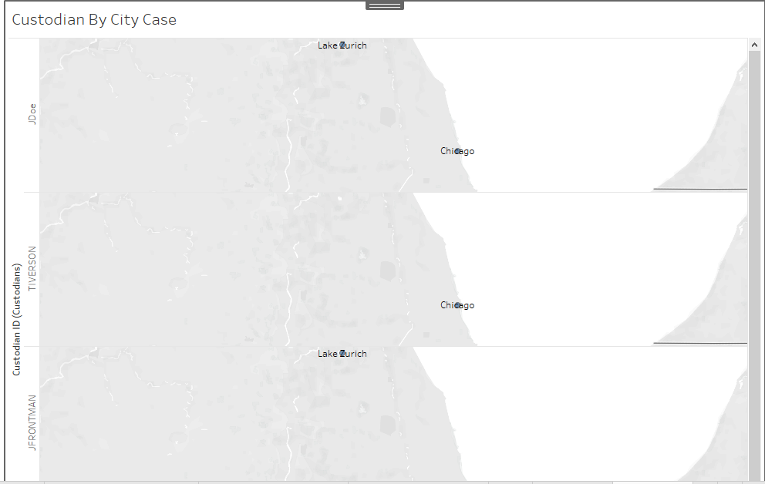
Dashboard 3 Tableau

Slide 21
Information Consumption
The main users consuming this information will be paralegals, review teams, project managers, lawyers, and judges who work with Winston Strawn.
This data is being set up to be used in a court of law.

Slide 22
Visualization
The data will be presented via Relativity Databases of Winston Strawn through a WebAPI as well as hard copy documents in a court of law.

Slide 23
Kimball Roadmap
Step 1: Figure out the Background of the Project and the problem.
Step 2: Set up the Goal of the project ie. (Warehouse Data and Present Via WebAPI).
Step 3: Figure out the sources of the data and set up a Sources fact table.
Step 4: Understand Winston Strawn’s BP.
Step 5: Set up the ETL Process/ Data Flow Diagram, Data Flow Users and BI Layer.
Step 6: Set up ERD and SQL Diagram.
Step 7: Understand the Dimensions of SQL Table.
Step 8: Create SQL Query to Understand the Data.
Step 9: Visualize the Data via Tableau.

Slide 24
Thank You

